Slide 1
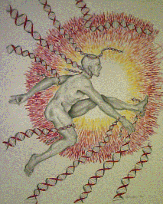
Analysis of the 1,000 Genomes data is enabling us to understand the basal level of variation in microsatellite loci – to discover new diagnostic markers, drug targets and toxicology tests
HPC Users Forum
September 7, 2011
Virginia Bioinformatics Institute
Virginia Tech

Slide 2


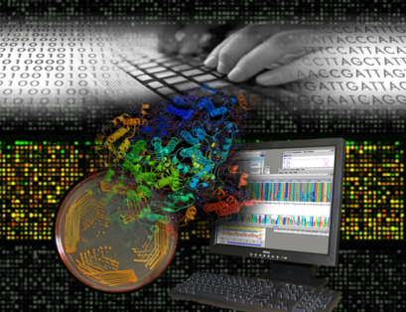


Virginia Bioinformatics Institute at Virginia Tech
Research
Divisions
For all who depend on the biomedical and life sciences,
VBI sets the pace in bioinformatics
by delivering breakthrough science that ensures health, security and welfare.
Research
Services
Business
Development
What is Bioinformatics?
Education &
Outreach

Slide 3

HPC for the Life and Medical Sciences is fundamentally different from that required for other disciplines
Most HPCLMS users are not developers: we have ~100,000 users a month
Work is data intensive, frequently with large memory, storage and bandwidth requirements
An effective HPCLMS facility has appropriate hardware mix, organized development environment/tools, organized and structured permanent/user data, developers that are computer and LMS savvy, and a critical mass of LMS Pis with interesting and supported projects.
The computing facilities at VBI include three data centers that occupy 2850 square feet.
Current resources encompass a mix of microprocessors, GPUs and FPGA), closely associated with data (>4 PB of disk array storage and 50 PB of fast tape storage).
Supported by NSF, NIH, DTRA, Darpa, USDA, nVidia, and a consortium of “partnership computing” users

Slide 4
The 1000 Genomes Project data is illustrative of where genomics is going, and the challenges to getting there
The NIH/NHGRI 1000 Genomes Project, launched in January 2008, is an international research effort to establish a large catalogue of human variation by sequencing ~2,400 individuals in 3 years.
  The first genome took 10 years and $3B. Current cost is <$10k.
  Technology is evolving rapidly
The Cancer Genome Atlas project at the NIH/NCI will sequence at least 200 forms of cancer, including tumors and non-tumor material from cancer patients.
  Thousands of genomes are being sequenced to understand how genomechanges interact to drive the disease, and will lay the foundation for improving cancer prevention, early detection and treatment.
Our goal in this research project is to establish a robust, reliable set of microsatellite (repetitive DNA sequences) sequences from which we could begin to make observations regarding the underlying genetics and statistical distributions of microsatellite repetitive elements therein.

Slide 5
What are Microsatellites?
Microsatellites are repetitive DNA sequences, typically 1-6 bases are repeated
There are ~500,000 to 2,000,000 such repetitive regions in the human genome
They are highly variable, much more than single nucleotide polymorphisms (SNPs)
They are the key element in forensics and paternity testing

Slide 6
Analysis of the human genome has focused on changes at single DNA bases, SNPs.
There is a large discrepancy between the know heritability of disease and the genetic component that can be explained by SNPs.
So, the other variable genomic component, repeated DNA, may account for the missing genetic disease component. Microsatellites are understudied despite playing a role in a number of diseases: Machado-Joseph (CAG repeat), Haw River Syndrome (CAG), Huntington’s Disease (CAG), some forms of Fragile-X Syndrome (CGG), Friedreich’s Ataxia (GAA), Myotonic Dystrophy (CAG), and virtually all cancers, to name a few….
….because they are difficult to measure, and could not be measured en masse until we developed techniques to do so….

Slide 7
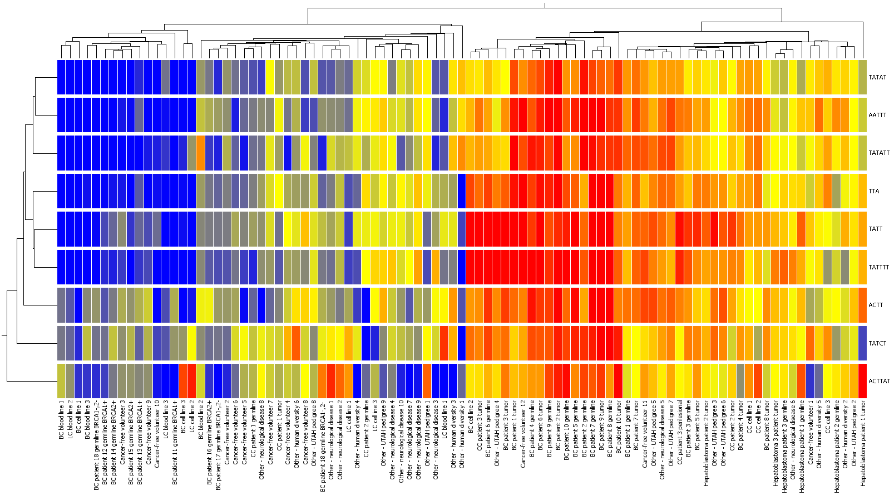
Cancer (tumor and germline) has a unique Microsatellite signature defined by 9 core motifs
Accepted Genes, Chromosomes and Cancer
All BRCA1/2+ patients (germlines)
All Familial BC (germlines)
All BC cell lines (except triple negative)
All LC cell lines
10 Cancer-free volunteers
15 Other (4 diversity, 8 neurological, 3 UTAH)
10 BC patients (tumors and germlines)
All hepatoblastoma patients (tumors and germlines)
1 BC cell line (the only triple negative)
All 3 CC tumor cell lines
2 cancer-free volunteers
10 Other (2 diversity, 2 neurological, 6 UTAH)

Slide 8
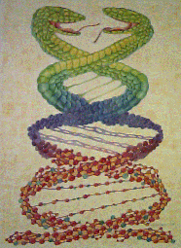
Development of microsatellite analysis methods for
1000 Genome Project data

Slide 9
First findings from the analysis of microsatellites in the genomes sequenced by the 1,000 Genomes Project
Global analysis of microsatellite repeat variation on the two kindreds (father, mother, and daughter) was very informative.
Standard alignment techniques perform poorly in microsatellite regions as a consequence of low coverage as indicated by approximately 79% of the informative loci exhibiting non-Mendelian inheritance patterns.
  Consensus assemblies are unreliable because the effective sequence depth at microsatellites is low, and because of some ‘algorithm’ errors (actually bad assumptions and choices to solving problems by programmers that do not know genetics).
We used a more stringent approach, in which robust allelotypes were computed only for those loci that had complete reads that spanned the repeat region. This resulted in 376,685 high reliability loci with 94.4% of the 1,095 informative repeats conforming to traditional inheritance.

Slide 10
Only reads that span a microsatellite can be used to reliably call the allelotype
340 bp
200 bp
Short reads
(from DNA
Fragments)
200 bp
60 bp
27 bp
60 bp
flanking sequence
flanking sequence
microsatellite
  Consensus sequences provided by the 1,000 Genomes Project do not accurately capture microsatellite variation, because they do not take into consideration that reads that do not span the repetitive and flanking regions are effectively irrelevant at those loci.

Slide 11
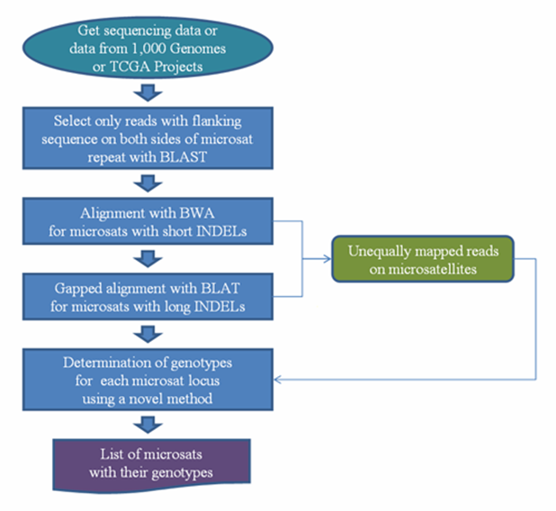
We have established a pipeline for the 1000 Genome Project and TCGA data
Repeat 2,000,000 times per genome
Thousands of genomes
Data mine the finished product
bwa aln part: ~4GB file (14 million 76 bp ready) takes 2 minutes on Convey HC-1. Or ~4 hours running on a sngle node 2x AMD Opteron 4174 ( 6 cores each, 2.8GHz, 6M Cache), 48GB RAM 1333MHz, with 4 NVidia Tesla GPU cards.

Slide 12
Computed microsatellite variation relative to the human reference genome shows a small amount of variation
The total number of microsatellites with high-confidence allelotypes:
Repeats sequenced at more than 2x and not more than 30x with a maximum of 2 alleles

Slide 13
We were able to call changes that are diagnostic of disease in high impact regions of the genome (exons).
Gene | Motif | Reference (hg18) | Utah Father (NA12891) | Utah Mother (NA12892) | Daughter (NA12878)
GPX1 | GCC | 6 | - | - | 5(3)
MAML3 | CAG | 9 | - | - | 8(9)
PRDM15 | CAG | 5 | 5(3) | - | 6 (2), 5 (2)
TMIE* | TTC | 9 | 9(5) | - | 8(3)
Gene | Motif | Reference (hg18) | Nigerian Father (NA19239) | Nigerian Mother (NA19238) | Nigerian Daughter (NA19240)
HAVCR1 | ACA | 4 | - | - | 3(8)
MAML3 | CAG | 9 | - | - | 8(23)
NOTCH4 | CAG | 10 | - | - | 9(3)
NOTCH4 allele associated with schizophrenia
HAVCR1 allele confers protection against atopy, inflammatory and immune related diseases including asthma, in individuals which have been previously infected with Hepatitis A, a virus whose exposure is common among children in Nigeria
GPX1 allele is associated with breast cancer

Slide 14
1,000 Genomes Project Pilot 3 data is ripe with repeat variation discoveries
The 697 genomes included in the 1000 Genomes Project pilot study 3 were sequenced on a variety of second generation sequencing platforms: ABI SOLiD, 454, and Illumina. These samples cover 7 populations from the USA, China, Italy, Kenya, Nigeria, and Japan.
Of the 697 genomes, 570 were sequenced at the minimum read length, resulting in an average depth of coverage in targeted regions of 42.6x depth. The effective coverage at microsatellite loci was ~16x.
We analyzed a total of 2,993 microsatellite loci from 570 individuals sequenced by the 1000 Genomes Project.
  From the 549 microsatellite loci contained in the targeted exon regions, we found 31 variable loci, for a total of 9004 variations in the population, or 16 variations per genome.
  None of these microsatellite variations were identified using standard variant calling methods though 60% have been previously documented and all are located in genes associated with cancer.

Slide 15
Variations at exonic microsatellite loci have high potential for impact

Slide 16
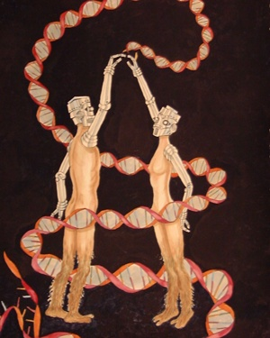
Where from here?

Slide 17
And what is next?
Establish robust routine to target enrich deep sequence samples to provide supplemental raw data for more complete microsatellite genome sequencing.
Compare the microsatellite genomes allel distributions of 1000 Genomes Project data (‘normal’) and The Cancer Genome Atlas data (‘cancer’) to identify informative loci, and then pursue them.
Perform target enrichment deep sequencing to measure the microsatellite genome in more cancer samples, neurological disease samples and cell lines exposed to various stressors.
And…

